Slide 1
What is environment ?
The word environment comes from the French word ‘Environ’ which means to surround.
Environment means what surrounds us. It may be living or non-living things. It includes physical, chemical and other natural forces. Living things live in their environment. They constantly interact with it and adapt themselves to conditions in their environment. In the environment there are different interactions between animals, plants, soil, water, and other living and non-living things.

Slide 2
What is eco-system
An ecosystem is a geographic area where plants, animals, and other organisms, as well as weather and landscape, work together to form a bubble of life.
Ecosystems contain biotic or living, parts, as well as abiotic factors, or nonliving parts.
Biotic factors include plants, animals, and other organisms.
Abiotic factors include rocks, temperature, and humidity.

Slide 3
What are the components of eco-system
There are two main components of an ecosystem which are in constant communication with each other.
They are the biotic components and the abiotic components.

Slide 4
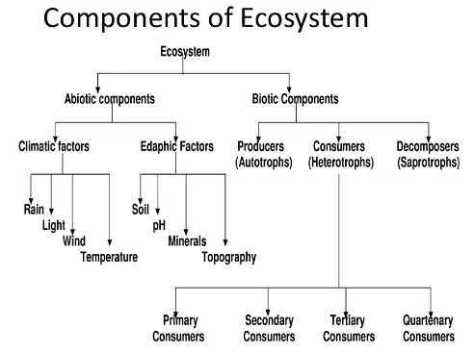

Slide 5
Biotic Components of Ecosystem
The living components of an ecosystem are called the biotic components. Some of these factors include plants, animals, as well as fungi and bacteria. These biotic components can be further classified, based on the energy requirement source. Producers, consumers, and decomposers are the three broad categories of biotic components.
Producers are the plants in the ecosystem, which can generate their own energy requirement through photosynthesis, in the presence of sunlight and chlorophyll. All other living beings are dependent on plants for their energy requirement of food as well as oxygen.
Consumers include herbivores, carnivores, and omnivores. The herbivores are the living organisms that feed on plants. Carnivores eat other living organisms. Omnivores are animals that can eat both plant and animal tissue.
Decomposers are the fungi and bacteria, which are the saprophytes. They feed on the decaying organic matter and convert this matter into nitrogen and carbon dioxide. The saprophytes play a vital role in recycling the nutrients so that the producers i.e. plants can use them once again.

Slide 6
Abiotic Components of Ecosystem
Abiotic components are the physical and/or the chemical factors that act on the living organisms at any part of their life. These are also called as the ecological factors. The physical and chemical factors are characteristic of the environment. Light, air, soil, and nutrients, etc. form the abiotic components of an ecosystem.
The abiotic factors vary from ecosystem to ecosystem. In an aquatic ecosystem, the abiotic factors may include water pH, sunlight, turbidity, water depth, salinity, available nutrients and dissolved oxygen. Similarly, abiotic factors in terrestrial ecosystems can include soil, soil types, temperature, rain, altitude, wind, nutrients, sunlight etc.
Here, the sun is the energy source. Producers/plants use this energy to synthesize food in the presence of carbon dioxide and chlorophyll. The energy from the sun, through several chemical reactions, turns into chemical energy.

Slide 7
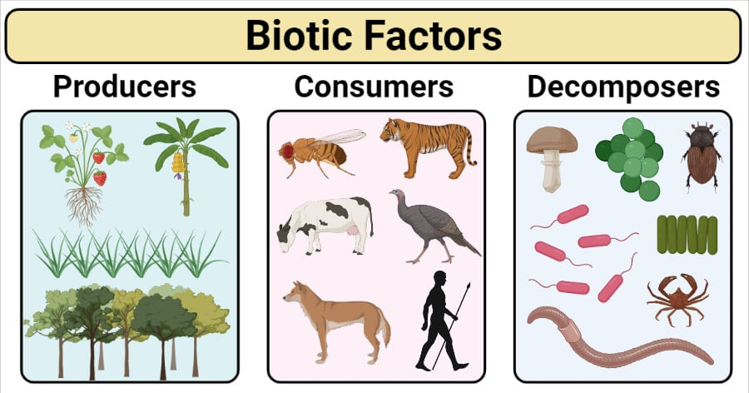

Slide 8
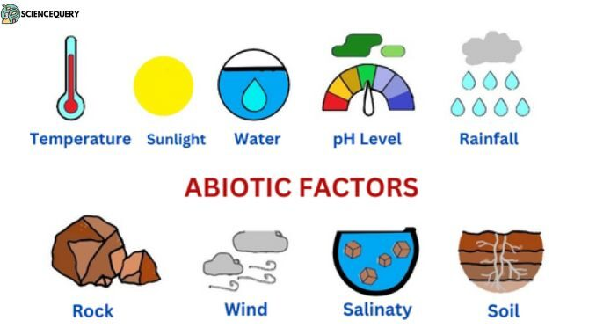

Slide 9
Name :- Om Vinod Zunzurke Class :- 10 A THANK YOU

